Slide 1
Intro to Data Science
Final Project – Supplemental Lesson
Python for DS
UW Robinson Center – Summer Stretch 2024
Notes:
Slides by Bella Chang

Slide 2
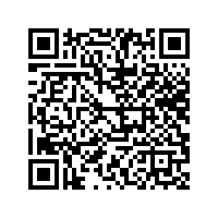
Feedback Form💬
Python for DS

Slide 3
Announcements📣
Final project presentations will be on THURSDAY this week
Feel free to invite your parents, BUT HAVE THEM EMAIL US FIRST if they plan to attend!
All homework is due TODAY
If you need more time, let us know ASAP
Each day we will have time for group work
Today we will be covering lecture material towards projects on data science (data analysis & ML)
Please pay attention & follow along on your own Jupyter Notebook; we will leave time for group work in the afternoon

Slide 4
Overview of Final Project – Expectations
(Review of Last Week)
Python for DS

Slide 5
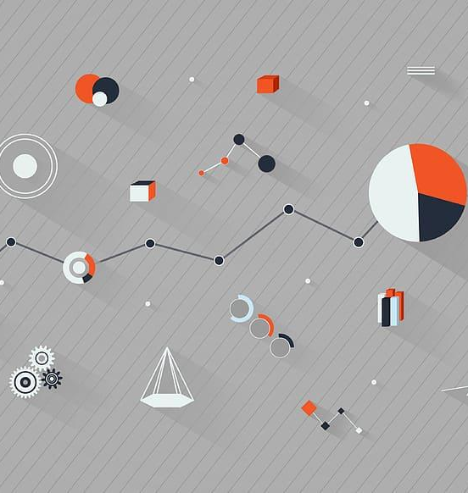
Plan for Today
Morning
Afternoon
Overview lecture of DS, ML, data analysis (conceptual)
Data analysis demo
Guest lecture (Lauren Bricker) with Discrete Mathematics class
ML demo
Group work
Get approval from teachers on your project!

Slide 6
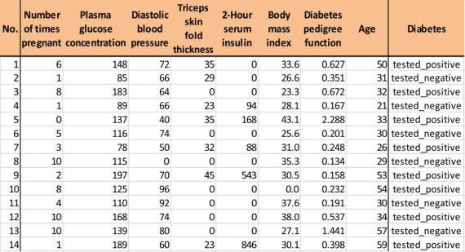
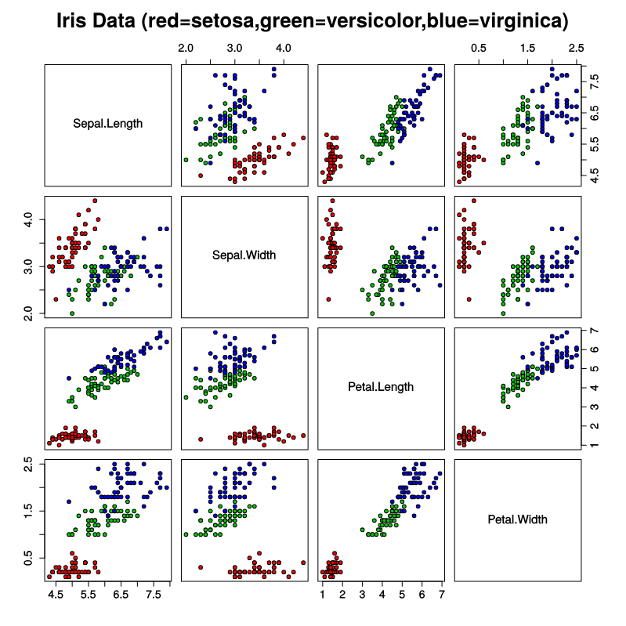
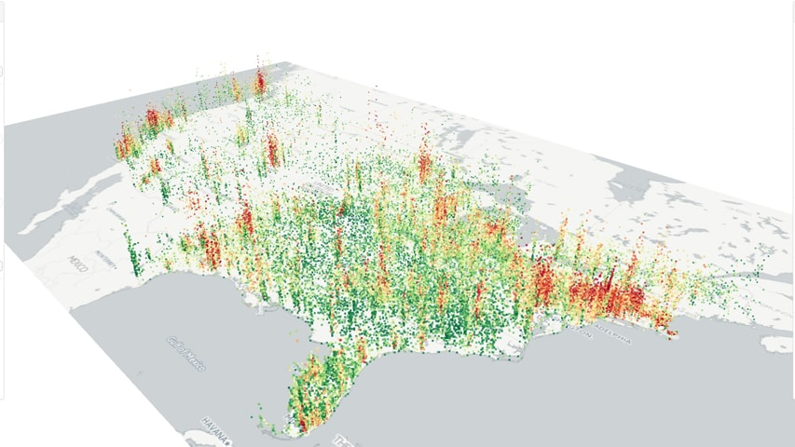
Data Science

Slide 7
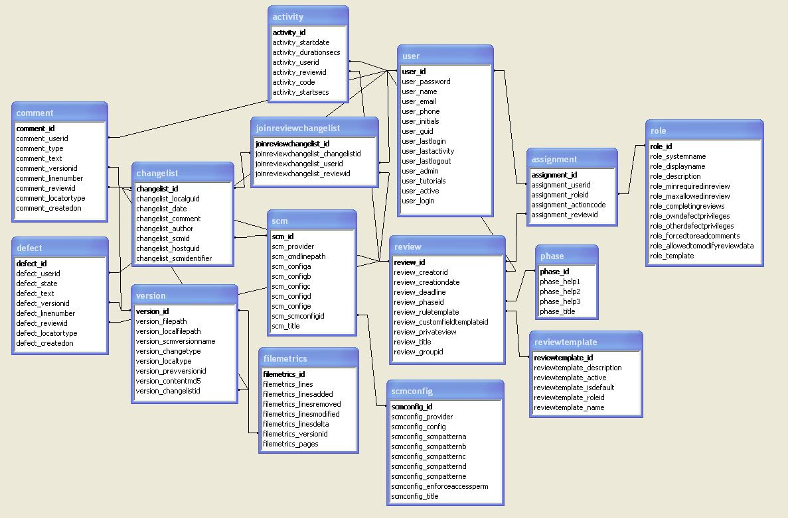
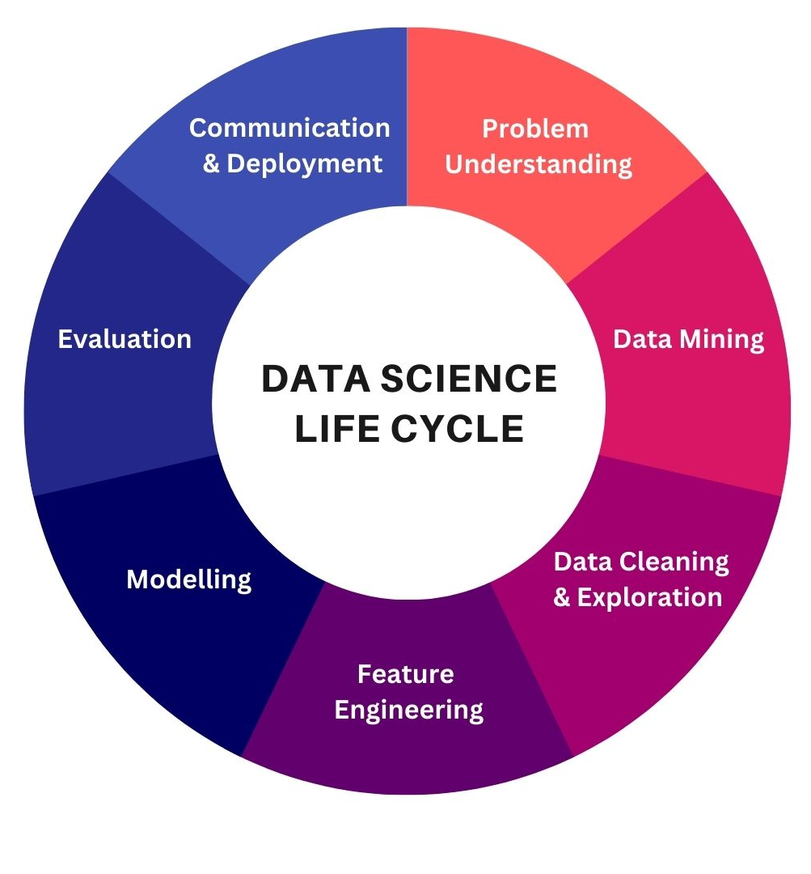
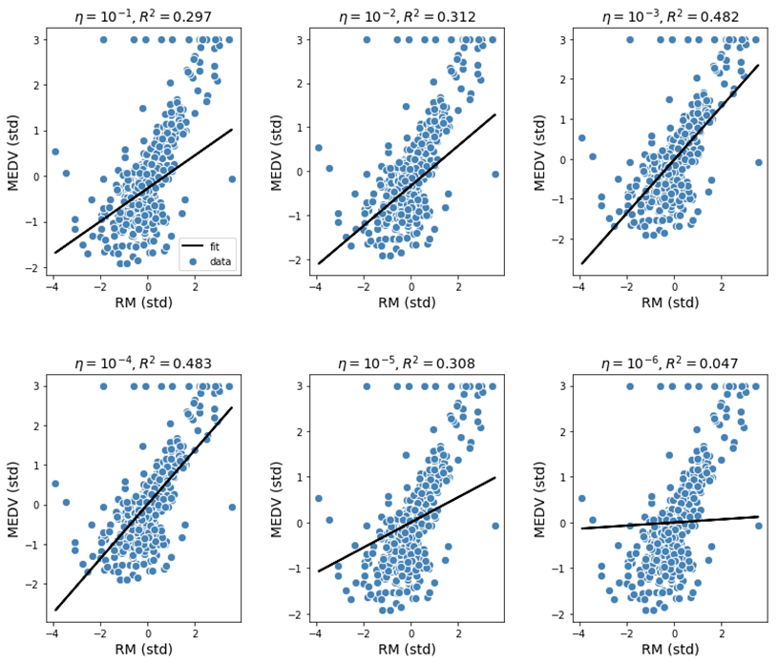
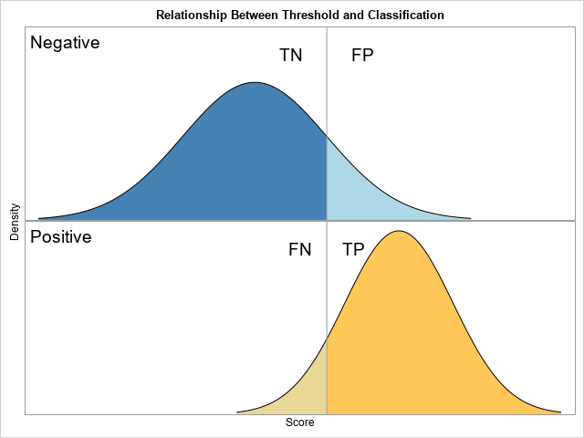
Data Science

Slide 8

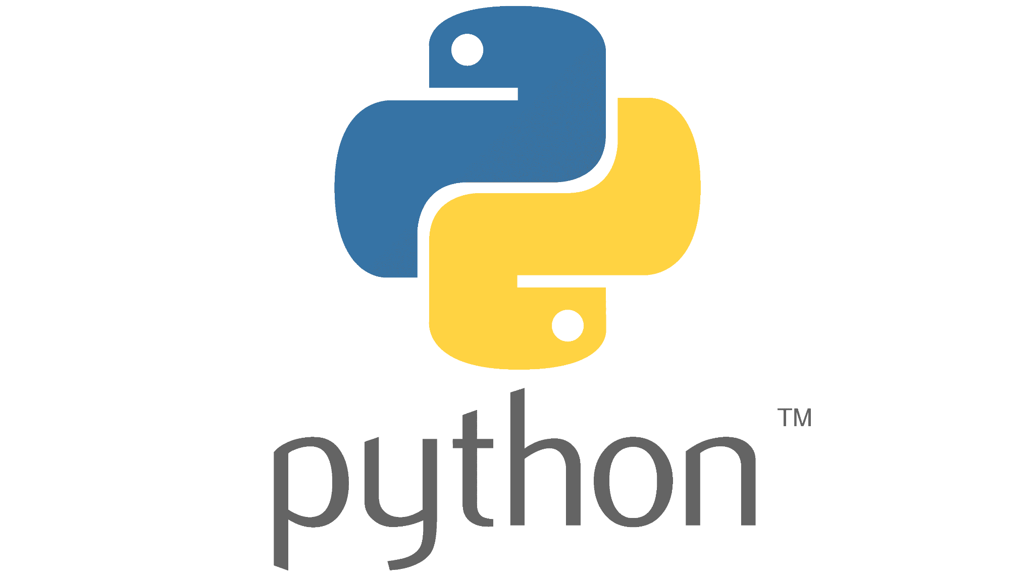
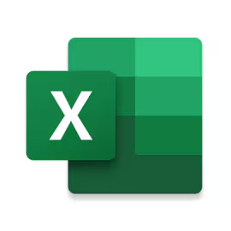




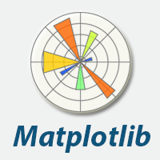


Tools in DS
LIBRARIES
SOFTWARES

Slide 9
DS vs CS
Data Science
Computer Science
Shared Features
Require background in mathematics and coding
Both backgrounds can be used for more advanced work in machine learning, AI, and research
Working primarily with data
Branches into data engineering, data analysis, and mathematical/statistical modeling/inference
Strong statistics knowledge required
Working primarily with software
Branches into software engineering, software development, and hardware jobs
Less statistics needed (unless ML) => requires more of a

Slide 10

Data Analysis
Python for DS
Finding UNDERLYING TRENDS behind a set of data and VISUALIZING the data; detracting MEANING from data

Slide 11
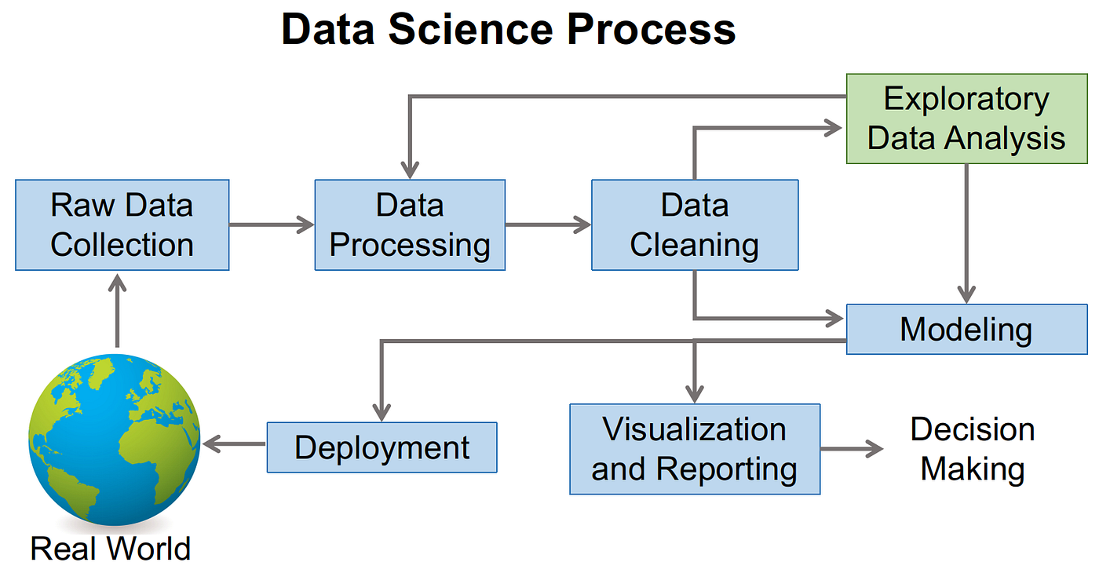
EDA (Exploratory Data Analysis)

Slide 12
Pandas Basics
PANDAS is a library in Python used to query DATASETS
It has its own unique set of syntax
Some essential functions:
Grabbing a COLUMN from a pandas df => df[column_name]
Finding ALL ROWS THAT MATCH A CONDITION (Boolean indexing) => df[df condition]
Ex: df[df[“Fruits”] == “apple”] gets you all rows in your dataframe WHERE fruit = apple
Filling all NaN values => df.fillna()
Etc. (this is definitely not all of them, please look for documentation or ask help for more!!)
Notes:
Pull up demo if there is some time

Slide 13
Creating Visualizations
Matplotlib/Seaborn => most reliable libraries for standard visualizations
Plotly => interactive visualizations (can hover over, zoom in using trackpad)
ALL VISUALIZATION LIBRARIES have their own syntax!!!
When thinking about visualizations:
What is the best visualization for my particular output and features?
What looks the most appeasing and digestible for viewers?

Slide 14
Creating Visualizations
Matplotlib
https://matplotlib.org/stable/gallery/index.html
Seaborn
https://seaborn.pydata.org/examples/index.html
Plotly
https://plotly.com/python/

Slide 15
Creating Visualizations
LABELS, LABELS, LABELS!
Label everything! Axes, colors you use, title…
Create LEGENDS
We want varieties of visualizations
Capture trends clearly that support your overarching argument
Challenge yourself!!
How can I show multiple features in one graph that isn’t overcrowded?
How can I create subplots?
etc.

Slide 16
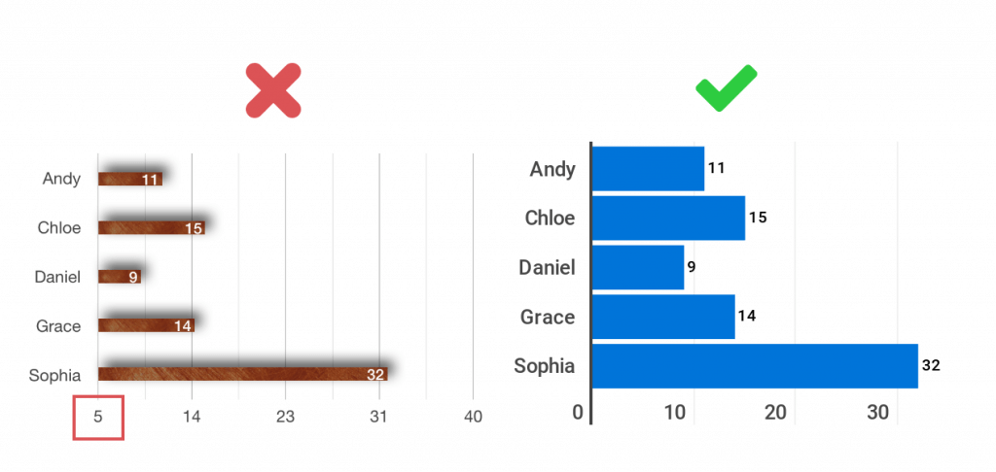
Good vs Bad Data Vis

Slide 17
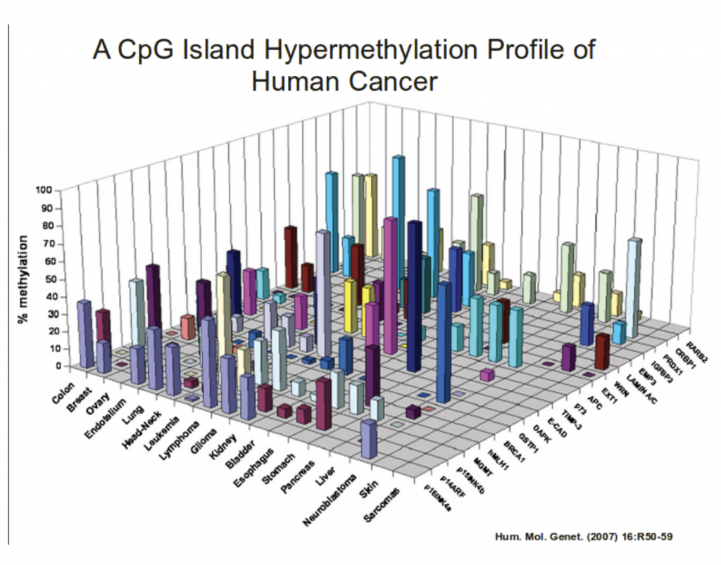
Good vs Bad Data Vis

Slide 18
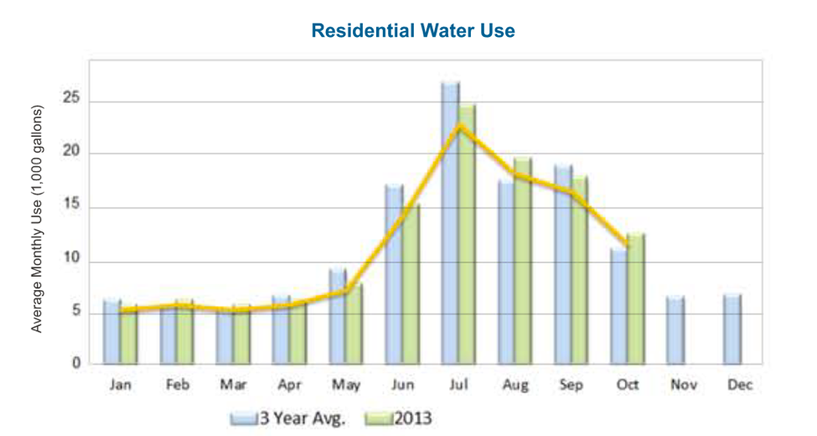
Good vs Bad Data Vis

Slide 19
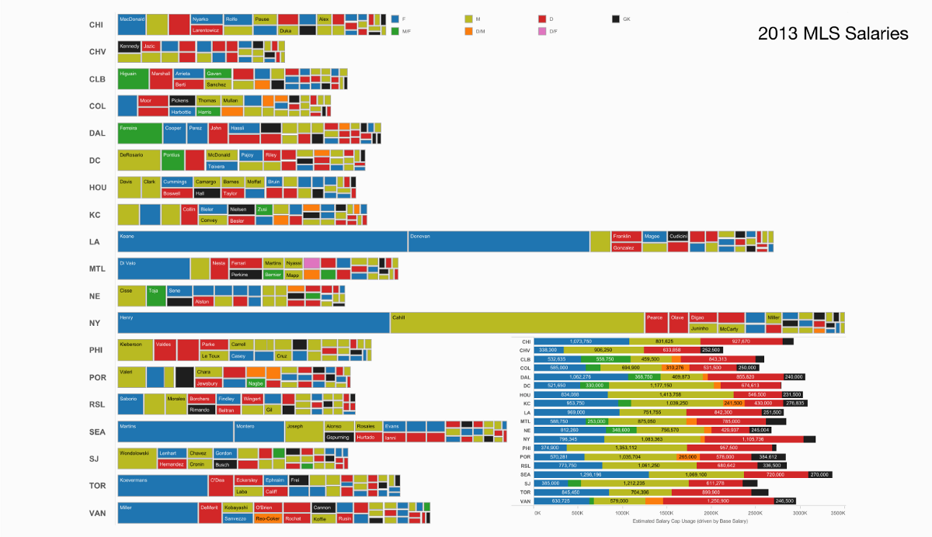
Good vs Bad Data Vis

Slide 20
Expectations for analysis projects –
Create a question that needs data to back it up
Examples: What kind of songs were popular in 2023? Who have the best paid athletes been through time and what do they have in common?
Finding a dataset to answer your question (Kaggle)
Cleaning the dataset
Mapping 5 visualizations showing different findings
Explaining findings and how they answer your question

Slide 21
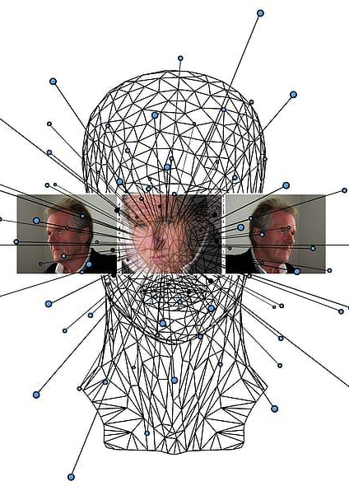
Machine Learning
Python for DS
MACHINE takes in data, and LEARNS underlying trends to predict similar patterns later on that replicate that behavior

Slide 22
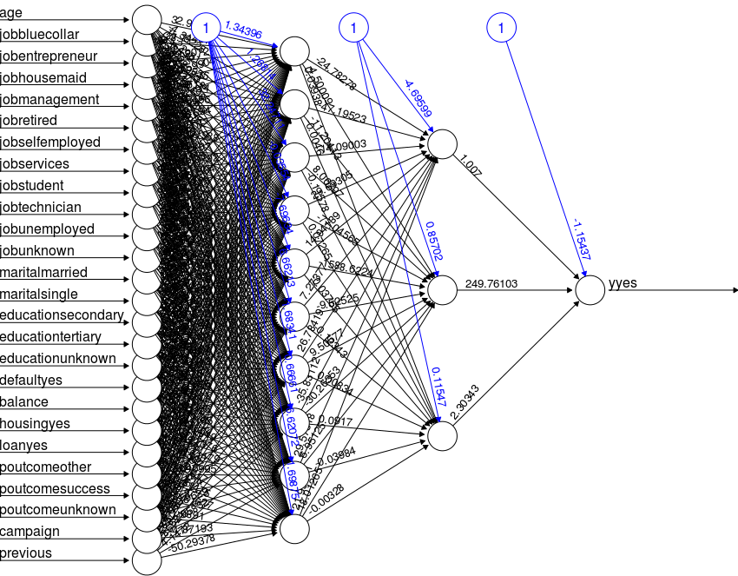
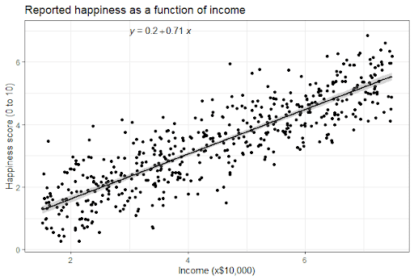
ML, in the real world

Slide 23

ML at a simple level
Two most basic forms of ML: regression & classification

Slide 24
Regression
QUANTITATIVE predictions
Takes in a variety of other features and predicts a NUMBER
Ex: to predict house prices, we can take in features like the square footage, # of bathrooms, neighborhood, etc.
y = mx + b => this is LINEAR REGRESSION!
Simplest form
Can expand to quadratic, exponential, … regression

Slide 25
Classification
CATEGORICAL predictions
Takes in a variety of features and predicts a CATEGORY
Ex: to predict if an email is spam or not, we can take in features like the number of punctuation, how long the email is, number of symbols, etc.
AKA, logistic regression (very mathy why it is also technically regression!)
Simplest form of classification = BINARY classification (yes/no)

Slide 26
Expectations for ML projects –
Finding a dataset that matches the kind of ML you hope to do (regression or classification are your 2 options)
Cleaning the dataset
Exploratory data analysis
Feature selection
Creating the model with an ML library
Document accuracy of model

Slide 27
Feedback Form💬
Python for DS

Slide 28
Work Time!
Python for DS
Remember to:
Check in with instructors to check on group project
Ask any questions on any demos we’ve had!
ML
Data Analysis
Game making
App interface

